Slide 1

2019

Slide 2
Data Science and AI
Module X
Capstone Project

Slide 3
Capstone Project
You are required to define, design and deliver a data science project towards the end of the course.
Project milestones:
~ -8 weeks: present 3 ideas for the project
~ -6 weeks: decide on one option
~ -5 weeks: collect data
~ -4 weeks: present initial findings
~ -2 weeks: present an update
- 1 week: Dry run of final presentation
Last day of course: Present final report

Slide 4
What to present
Business perspective
Business insights uncovered
Business scenarios for how the project can be deployed and used
Approach for estimating business value
Technical perspective
Techniques used
Pipeline
Model validation results

Slide 5
Project evaluation criteria
The project is evaluated on the quality, clarity and completeness of the definition, design and delivery of the project.
Definition (20%)
Business context, stakeholders and value
Data description, sources, quality
Design (30%)
Data exploration, analysis and visualisation
Documentation: text document, presentation and Notebook
The project planning, effort allocation and next steps
Delivery (50%)
Feature Engineering
Creation of an effective reproducible pipeline
Machine Learning model algorithms and accuracy
Overall end-to-end solution
Delivery of the presentation, poise and audience engagement

Slide 6
Questions?

Slide 7
Presentation Skelton

Slide 8
Project Title Capstone Project Presenter’s name and role (ideally Data Scientist)

Slide 9
Agenda
Bio
Project Context
Define
Design
Deliver
Summary, conclusions and next steps
Appendix: list of supporting documents
The agenda should be ideally repeated as a transition slide between sections

Slide 10
Bio
Education
Professional experience
Data science learnings and experience
Relevance to the project

Slide 11
Project context
Industry or domain
Problem area
Why is this area interesting?
Previous work in this area

Slide 12
Define
Business aspects
Stakeholders
Business question
Business value
Data science aspects
Data question
Data required
Data sourced
Data source, description, volume and quality
How is the data generated?
How it can be sourced in the future?

Slide 13
Design
Data exploration, analysis and visualisation
Include one slide for the highlights of your EDA
Overall process flow used
See next slide

Slide 14
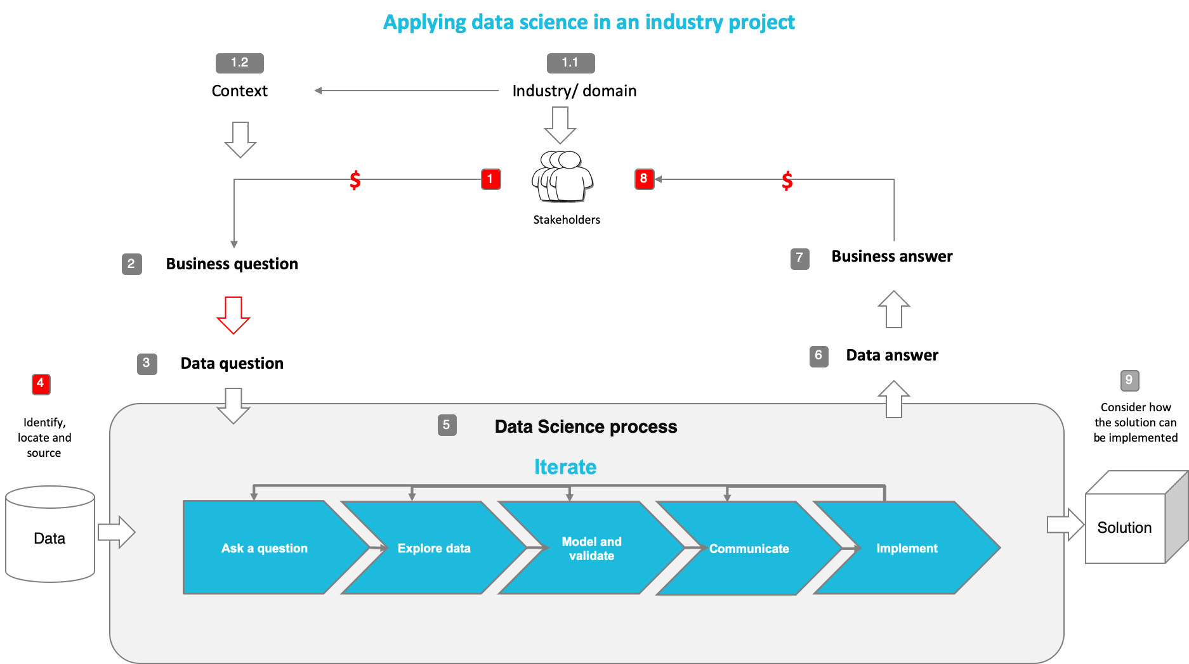
You may use this diagram or your simplified version with project relevant information

Slide 15
Deliver
Feature engineering
What are the most important features and what is the business significance
Machine models used and their evaluation metrics
How does the model fit in the overall solution
Who will use it?
When is it used?
How does it benefit the business?

Slide 16
Summary, conclusions and next steps
Summary
A brief recap of the presentation
Conclusions
What has been achieved?
Next steps
How can this project be developed further and implemented in real life?

Slide 17
Questions

Slide 18
Appendices

Slide 19
Mini Project
The objectives of this mini-project is to:
Apply all what you have learned so far
Prepare you for the Capstone project
Understand your learning gaps
Please present as if it is your job interview take-away test on:
Business aspects of the project
Outcomes
Potential additional insights that can be obtained from available data
Data analysis and Machine Learning techniques used
Gaps in your skills
Please listen actively to your fellow classmate’s presentation and ask questions as if you are the hiring manager

Slide 20
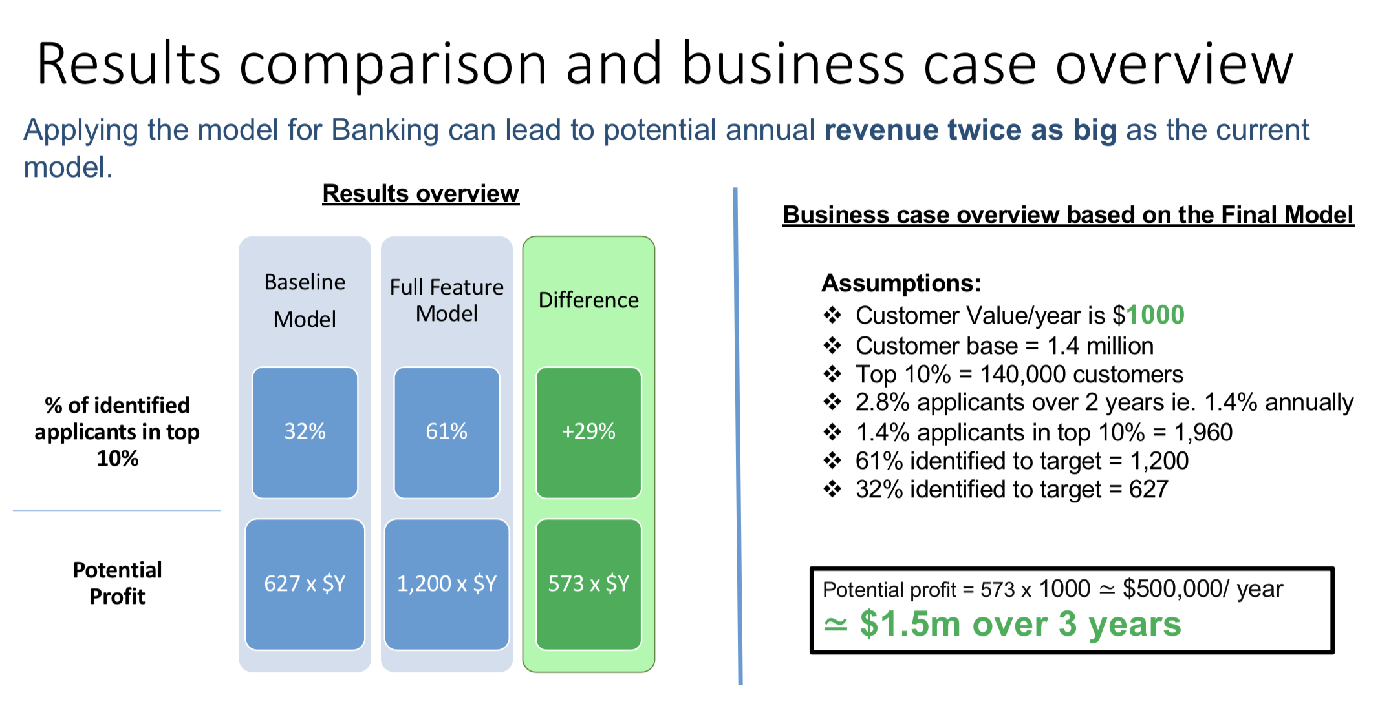
Case study: Home loans marketing

Slide 21
Appendices

Slide 22
Recommended modelling steps
Load data
Do minimal EDA
Use Dummy Classifier or Regressor (aka zero-information learning)
Use sckit-learn or do it by hand
Use a naive classifier or regressor (minimal learning). For example using 1 feature.
Improve on the above and iterate
Improving models:
Improve data
More data
Less NaN
Remove outliers
etc
Select your features
More features
Select algorithm
Make sure you compare at least 3
Hyperparameters tuning

Slide 23
End of Presentation!

